Slide 1
Kashmir issue
1947 till present

Slide 2
Why is Kashmir a dispute territory?
Why does India claim Kashmir (International matter) why Pakistan claims?
Significance of United Nation resolution and criticism on then?
What was Kashmir special status? or what was article 370 and 35A.
Why did India revoked the special status? Why is the revocation of the special status of Kashmir illegal?
Why is Kashmir a nuclear flash point? or why it is a time bomb?
What are the options for Pakistan to counter India bratelty?
A part from option for Pakistan. What are other solutions for Kashmir.
Can we use an international code of justice to resolve this matter.
Current situation.

Slide 3
Overview
Kashmir issue is considered one of the major issues of the world which involves complete cleansing of the people living there due to political and economic reasons.
The Conflicts took an important turn when the Indian Government specifically the Modi Group started a lock down in the Jammu Kashmir. The lockdown is considered as the deadliest because no aid was provided to Kashmiris and everything was banned in the specific area. The lock down started on 5th August 2019.
This inhumane behavior from the Modi Government caused a great uproar in Pakistan specifically and when Imran Khan raised voice against it so the international media also took notice and published many writings against the vicious attitude of India.
However, now the Kashmir issue is transformed into a humanitarian crisis and it is being addressed by many advocates of Human Rights in the entire world.

Slide 4
Many young men have been detained in this process and women also faced great terror acts by the Indian Army.
Since the anticipation of the lockdown, no foreign journalists have been allowed to report and see the conditions of Kashmiris.

Slide 5
Historical background
Kashmir, is region of the northwestern Indian subcontinent. It is bounded by the Uygur Autonomous Region of Xinjiang to the northeast and the Tibet Autonomous Region to the east (both parts of China), by the Indian states of Himachal Pradesh and Punjab to the south, by Pakistan to the west, and by Afghanistan to the northwest. The region, with a total area of some 85,800 square miles (222,200 square km), has been the subject of dispute between India and Pakistan since the partition of the Indian subcontinent in 1947

Slide 6
The northern and western portions are administered by Pakistan and comprise three areas: Azad Kashmir, Gilgit, and Baltistan, the last two being part of a territory called the Northern Areas. Administered by India are the southern and southeastern portions, Jammu and Kashmir and Ladakh
. The Indian- and Pakistani-administered portions are divided by a “line of control” agreed to in 1972
China became active in the eastern area of Kashmir in the 1950s and has controlled the northeastern part of Ladakh (the easternmost portion of the region) since 1962

Slide 7
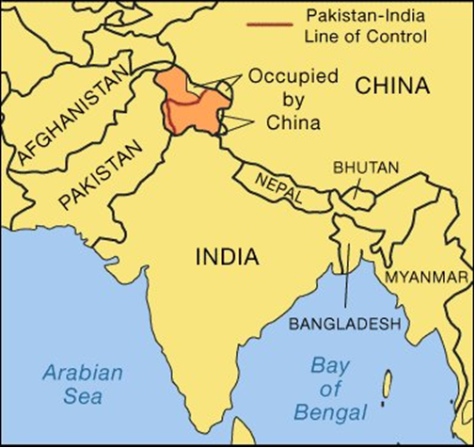

Slide 8
Kashmir has quite deep history as whole India has, it has been the hub of commerce and culture for Hindu Culture, remained other the Buddhist rule after Asoka came here.
After Muslims won the Kashmiri land so it came under the rule of Muslim Empire after 14th century. Muslim rule lasted in Kashmir for 5 centuries. Later Kashmir was annexed with Punjab in 19th century.
Raja Gulab Singh, the Dogra ruler of Jammu became the Maharaja of Kashmir. Kashmir worked as a buffer state for British to reach Indus water and to keep safe from Russia and China.

Slide 9
Kashmir issue emerged after the British withdrawal from the subcontinent.
According to the terms given by India and Pakistan, princely states were free to opt for the state they wanted to unite with certain reservations to remain independent.
At that time Maharaja Hari Singh believed that he will delay the decision so he would be able to keep Kashmir as an independent entity means not annexing with either India or Pakistan.
The problem arose when his Muslim subjects started rebelling and want their annexation with Pakistan, also the Pashtun tribesmen invaded Kashmir to support the rebel group.
This caused Maharaja to take the decision abruptly and he signed annexation with India, it lead to the emergence of conflict between India and Pakistan.

Slide 10
Pakistan tried to retaliate by sending forces and it is said that a bigger war was expected at that time but the United Nations involvement in the conflict helped it to settle in 1948.
The ceasefire between both the states officially took place in year 1949. Following year, India and Pakistan both defined ceasefire line.

Slide 11
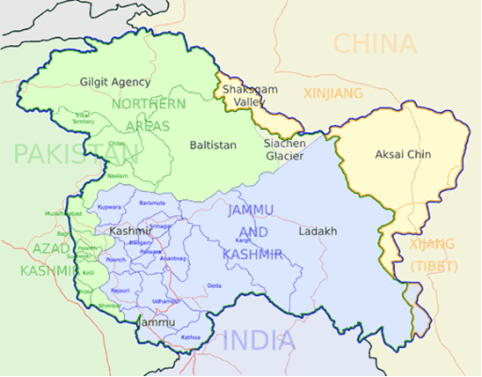

Slide 12
The War of 1965:
The 1965 war between India and Pakistan was the second conflict between the two countries over the status of the state of Jammu and Kashmir. The clash did not resolve this dispute, but it did engage the United States and the Soviet Union in ways that would have important implications for subsequent superpower involvement in the region.
The conflict started when Pakistan tried to infiltrate in the Kashmiri region to gain control for that it used military force. Also Pakistan claimed that India is trying to overtake Azad Kashmir by sending terrorist elements in it and Pakistan was trying to just responding to Indian activities.
The war ended with a stalemate.
It is said that the Cold war had also impacted the conflict as super powers were not in favor of any bigger conflict in South Asian region so they forced both countries to do seize fire.

Slide 13
Efforts to Resolve Conflict after 1971:
The war erupted between India and Pakistan and resulted in Fall of Dhaka.
However the borders with Kashmir became the line of control between both the nations and it was emphasized that both the nations must resolve their disputes through negotiations and diplomacy rather than engaging into a war.
In 1974, the opposition of plebiscite drops its demand in return of more power in autonomous structure of Kashmir.
Thus Sheikh Abdullah became the chief minister and ruled the Kashmir till his death in 1980s.

Slide 14
Post 1980 Crisis
The tension again started to increase between India and Pakistan as India did not conducted fair election in Jammu Kashmir which escalated tension in Kashmir and pro-independence forces tried to protest against Indian forces.
On the other hand India forces claimed that Pakistan is involved in the insurgencies happening with in Kashmir to worsen the crisis.
The insurgency escalates after the Indian Army kills about 100 demonstrators at Gawakadal Bridge.
Attacks and threats lead to the flight of almost all Hindus from the Kashmir Valley area of the state.
India imposes Armed Forces Special Powers Act (AFSPA) in Jammu and Kashmir.

Slide 15
1990s and Kargil War
The root cause of the conflict lies in Kashmir issue. Claims from India were as usual that Pakistan was trying to infiltrate the territory through terrorist activities however Pakistan also blamed India that it attacked Pakistan army before anything else and that’s why hostilities started.
For Pakistan, it was a defensive strategy, which ultimately went towards a permanent conflict. This conflict erupted along the Line of Control (LOC) in Kashmir.
Many agreements related to borders were already signed between both countries like Cease Fire Line in 1948 and Simla Agreement and Line of Control (LOC) in 1972.

Slide 16
For Pakistan things were going wrong and she started to realize that this is the time to deter the Indian atrocities.
India attacked Nellum Valley on regular basis and for that Pakistan responded and started to attack Dras-Kargil road, Where India faced much difficulty because Indian supply route was blocked.
Pakistan army had subjugated the Kargil and some posts which came under the dominions of India and the height advantage also went to Pakistan.

Slide 17
For that, Indian firstly targeted the Tiger Hill with full power, in this operation India managed to recapture some of the important territories.
Both countries had lost many soldiers in this area. Then clash was started in Dras Sector, where India simply damaged the Pakistan army and this post was also recaptured by Indian.
India faced a lot of problem from the Mujahedeen of Kashmir in every step of their planning.
Many Indian soldiers had been killed by Mujahedeen.
India initiated its final attack on Pakistan army on every occupied area and got about 80% of its territory back in their pockets.

Slide 18
At the end, Pakistan withdrew from Kargil because of the pressure of America.
American role in this conflict was an obvious fact.
It looks like that America was playing neutral role in this conflict but the reality stands somewhere else.
American adopted a unilateral approach and that was Pakistan must withdraw from Kargil.
Indian diplomats were completely exploiting the existed conditions during Kargil conflict.
The image of Pakistan came in international community as a hostile and terrorist country.
On the other hand, America was not happy of Pakistan nuclear program.

Slide 19
Diplomatic Moves by Pakistan
Many Pakistani leaders tried to resolve the conflict through diplomatic efforts.
Prime Minister Feroz Khan Noon offered pure and simple partition to the United States’ Permanent Representative to the United Nations, Henry Cabot Lodge, in Karachi on 10 February 1958.
Ayub Khan also suggested alternatives to plebiscite.
The Z.A. Bhutto – Swaran Singh talks central focus was on partition.
In 1997, Indian Prime Minister I.K Gujral and Prime Minister of Pakistan, Nawaz Sharif agreed to hold dialogues on eight bilateral issues including Kashmir. However, the nuclear tests of May 1998 blocked the process.
Pakistan started the dialogue process again in 2004 when Kashmir was discussed at the foreign secretaries’ level.

Slide 20
Several Confidence building measures were taken during several areas.
One such attempt regarding solution of Kashmir issue was made during Musharraf era.
In 2006 General Musharraf who believed both Pakistan and India would have to retreat from positions held since 1948 come up with four point formula.

Slide 21
This four-point solution to Kashmir issue which includes demilitarization and “self-governance with joint supervision mechanism”. The four-point formula of Musharraf included:
a) Kashmir should have the same borders but free movement across the region be allowed for people on both side of LoC.
b) There should be self-governance or autonomy but not independence
c) Region should be demilitarized i-e phased wised withdrawal of troops from the region.
d) And a mechanism should be devised jointly so that the road map for Kashmir is implemented smoothly.

Slide 22
Several differenced emerged at India’s end as Prime Minister Manmohan Singh said that Kashmir is an integral part of India and can never be separated.
So they will not be withdrawing from the borders of Kashmir.
India claimed over that area of Kashmir as well which is Pakistani administered.
Thus there were many obstacles while implementing 4 points formula presented by Musharraf.

Slide 23
Situation in 2019

Slide 24
An important incident which took place was invoking of Article 370 of the constitution by the Indian government.
This article has wave off the special status given to Kashmiris at the time of independence.
When the protest started the Indian government imposed the lockdown on Kashmir and cut off all the communication services of that area which is Indian administered.
However the area administered by Pakistan is still free. Thousands of people were detained due to this lockdown, people faced no food and medicine supplies. We can say it’s a worst nightmare for Kashmiris.

Slide 25
In Feb 2019, an attack on Indian convoy took place in Indian controlled Kashmir; the attack is known to be the deadliest attack in history.
India claimed that Jaish-e-Muhammad was responsible for this attack.
Two weeks later, Indian shot air strikes on Pakistan for that Pakistan retaliated well.
Also Pakistan attacked Indian Kashmir through aerial artifacts and later shot down two Indian Army planes and captured one army official of India.
For the sake of easing the tension, Pakistan released that military official after two days of inquiry.

Slide 26
Lockdown In Kashmir
The 2019–2021 Jammu and Kashmir lockdown was a preventive security lockdown and communications blackout that had been imposed throughout the Indian-administered union territory of Jammu and Kashmir following the revocation of Article 370 which lasted until February 2021, with the goal of preemptively curbing unrest, violence and protests.
Most separatist leaders had and have been detained in the crackdown.
The Indian government had stated that the tough lockdown measures and substantially increased deployment of security forces had been aimed at curbing terrorism
The government did not want a repeat of the death and injuries seen during the 2016–2017 Kashmir unrest

Slide 27
The revocation and subsequent lockdown drew condemnation from several countries, especially Pakistan, which had lodged protests with India on multiple occasions.
On 5 February 2021 Jammu and Kashmir's Principal Secretary of Power and Information announced that 4G internet services would be restored in the entire union territory

Slide 28
Since the lockdown was brought into effect, no foreign journalist has been allowed by the Indian government to report from the new union territory of Jammu and Kashmir.
According to a 6 September 2019 report by the Indian government, nearly 4,000 people have been arrested in the disputed region.
Among those arrested were more than 200 local Kashmiri politicians, including two former chief ministers of the state of Jammu and Kashmir, along with more than 100 leaders and activists from the All Parties Hurriyat Conference

Slide 29
In the wake of Syed Ali Shah Geelani's death, a new preemptive blackout was done in early September 2021, which ended completely on 7 September 2021

Slide 30
Human Rights Violation in Kashmir
Human Rights Watch conducts regular, systematic investigations of human rights abuses in some sixty countries around the world.
It addresses the human rights practices of governments of all political stripes, of all geopolitical alignments, and of all ethnic and religious persuasions.
In internal wars it documents violations by both governments and rebel groups.

Slide 31
The Indian government violates many human rights through its repressive administration over Kashmir and these have been criticized by local and international bodies.
The United Nations High Commissioner for Human Rights highlighted extensive violations of human rights and torture imposed on civilians by armed forces
In a 1993 report, Human Rights Watch stated that Indian security forces "assaulted civilians during search operations, tortured and summarily executed detainees in custody and murdered civilians in reprisal attacks"

Slide 32
Massacres
The Indian security forces are also accused of many massacres. Some of them include:
Gawakadal massacre: On 21 January 1990, 51 civilians were killed by CRPF troopers during protests against earlier raids in which wanton arrests and molestation of women were conducted by CRPF troops.
Handwara massacre: On 25 January 1990, two BSF patrolling parties in Handwara indiscriminately fired at peaceful protesters and killed 25 people. Many people were injured.
Zakoora and Tengpora massacre: Indian forces killed 33 protesters and injured 47 on 1 March 1990 at Zakoora Crossing and Tengpora Bypass Road in Srinagar. The killers were not punished.

Slide 33
Hawal massacre: At the funeral of Mirwaiz Muhammad Farooq on 21 May 1990 over 60 civilians were killed by paramilitary forces and hundreds injured in the indiscriminate firing on the funeral procession.
Sopore massacre: On 6 January 1993 Indian troops killed 55 civilians in the town of Sopore and set fire to many homes and buildings.
Bijbehara Massacre: On 22 October 1993 the Indian Army killed 51 civilians during protests over the siege of the Hazratbal Mosque. 25 of those killed were students None of the accused were punished.
Kupwara massacre: On 27 January 1994 the Indian Army fired at and killed 27 civilians, mainly traders, in Kupwara district. Survivors say that the soldiers carried out the massacre to punish people for observing shutdown on 26 January.

Slide 34
Fake encounters and killings
Disappearances
Mass graves
Extrajudicial killings by security personnel
Torture
Women Rights violation

